Slide 1
Genetic Diversity and Evolutionary Dynamics of Bactrocera dorsalis Populations in Selected West African Countries
Ayomikun Aderounmu

Slide 2
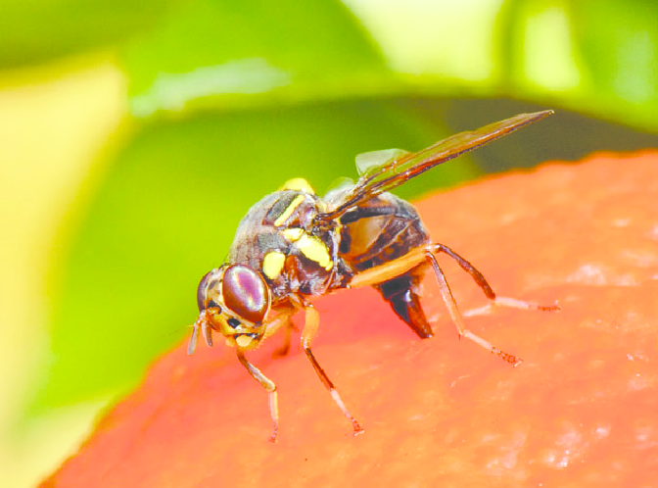
Introduction and problem statement
B. dorsalis is an invasive pest, native to Southeast Asia
Assess the genetic diversity and population structure of B. dorsalis in 3 West-African countries
It is a major pest of fruit crops infesting fruits of over 40 host plant species
Responsible for over 50% of crop losses due to infestation in Africa

Slide 3
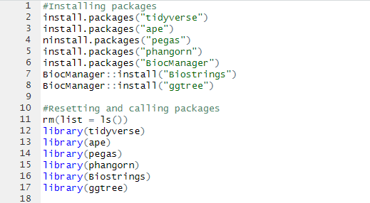
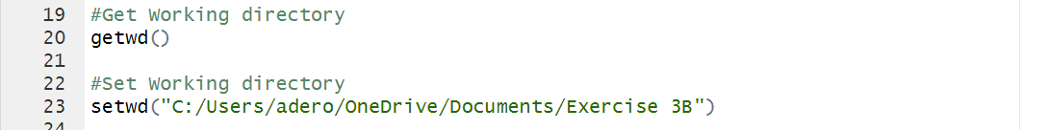
Installing and loading packages in R

Slide 4
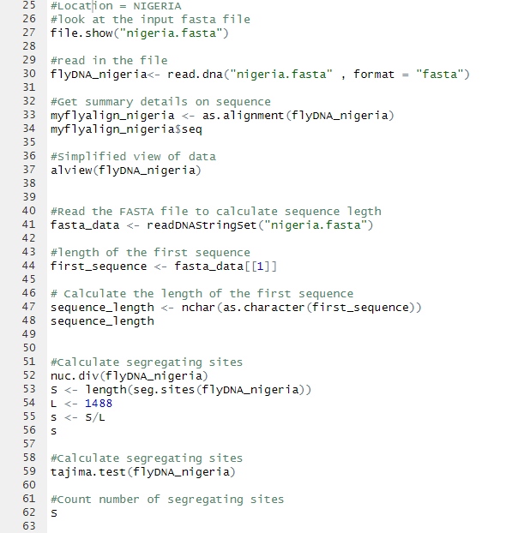
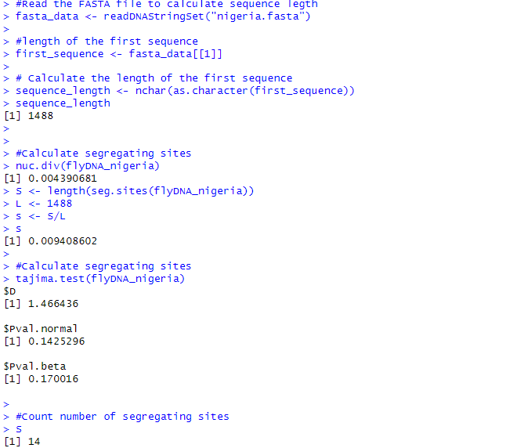
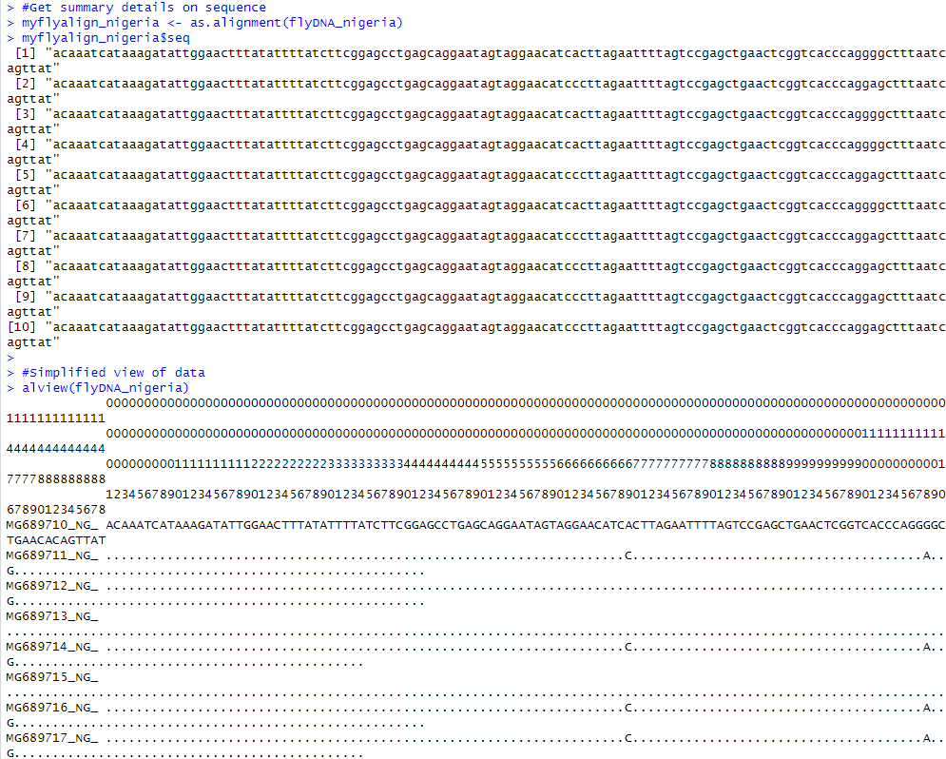
Analysis of B. dorsalis from Nigeria

Slide 5
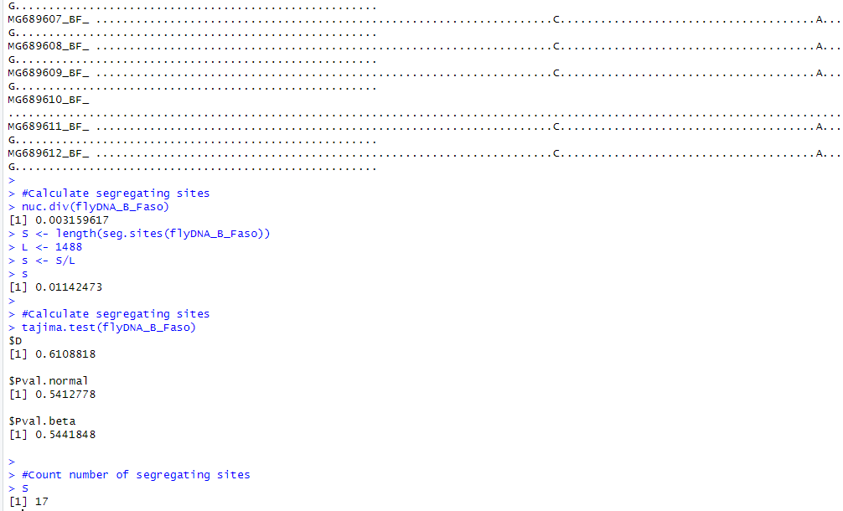
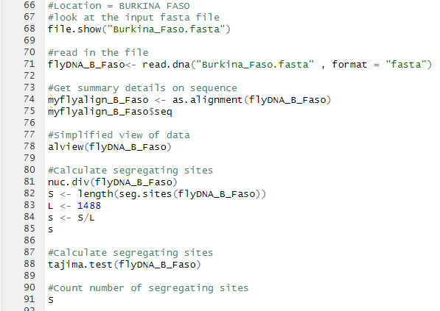
Analysis of B. drosalis from Burkina Faso

Slide 6
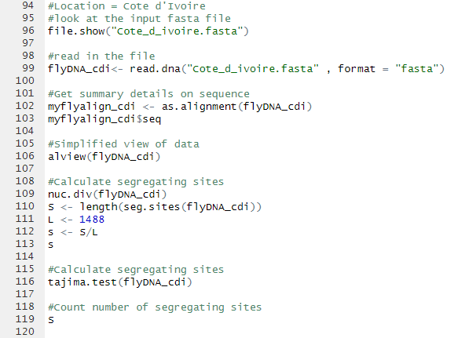
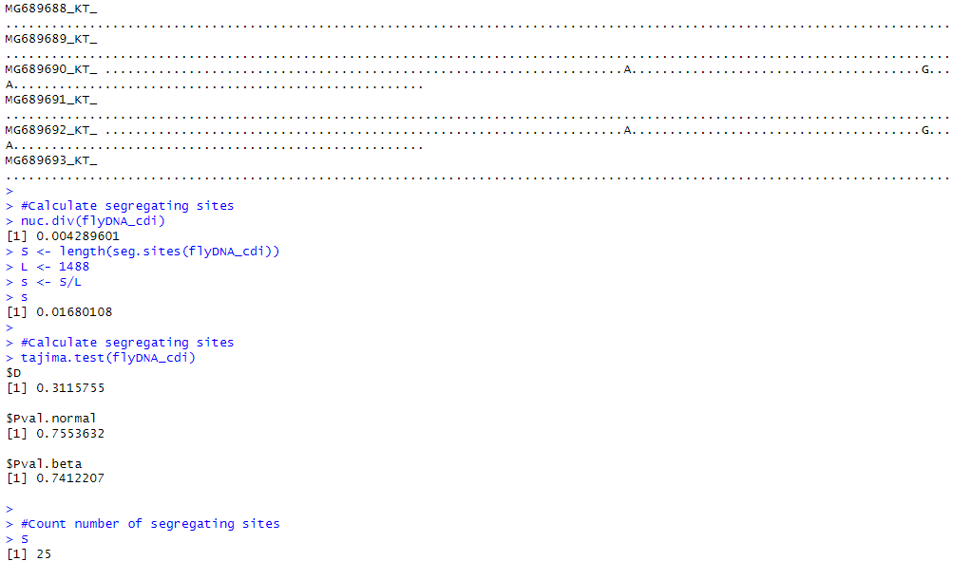
Analysis of B. drosalis from Cote d’Ivoire

Slide 7
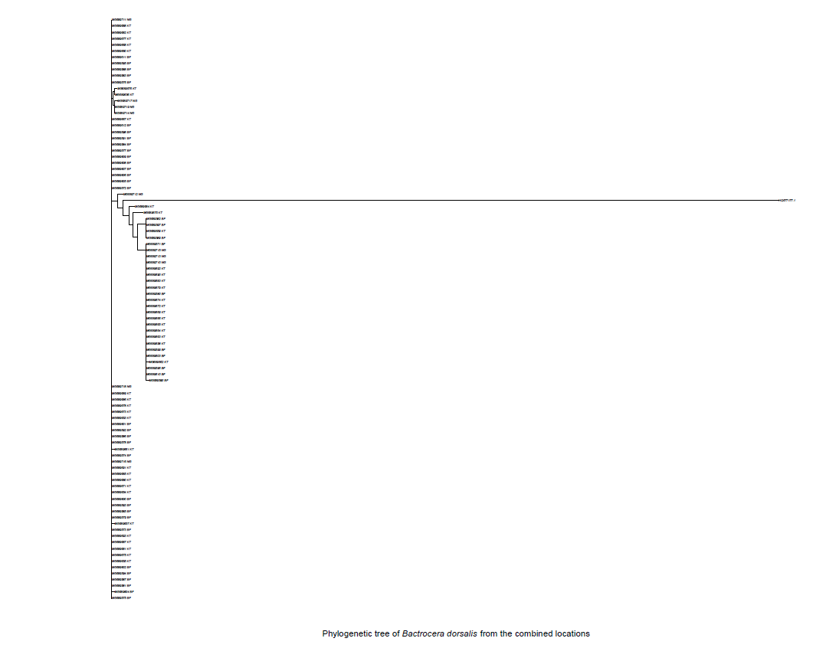
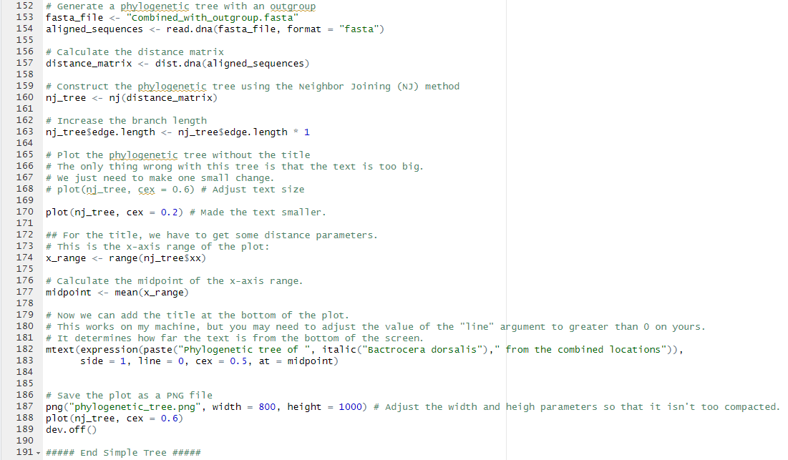
Phylogenetic analysis of the combined Locations

Slide 8
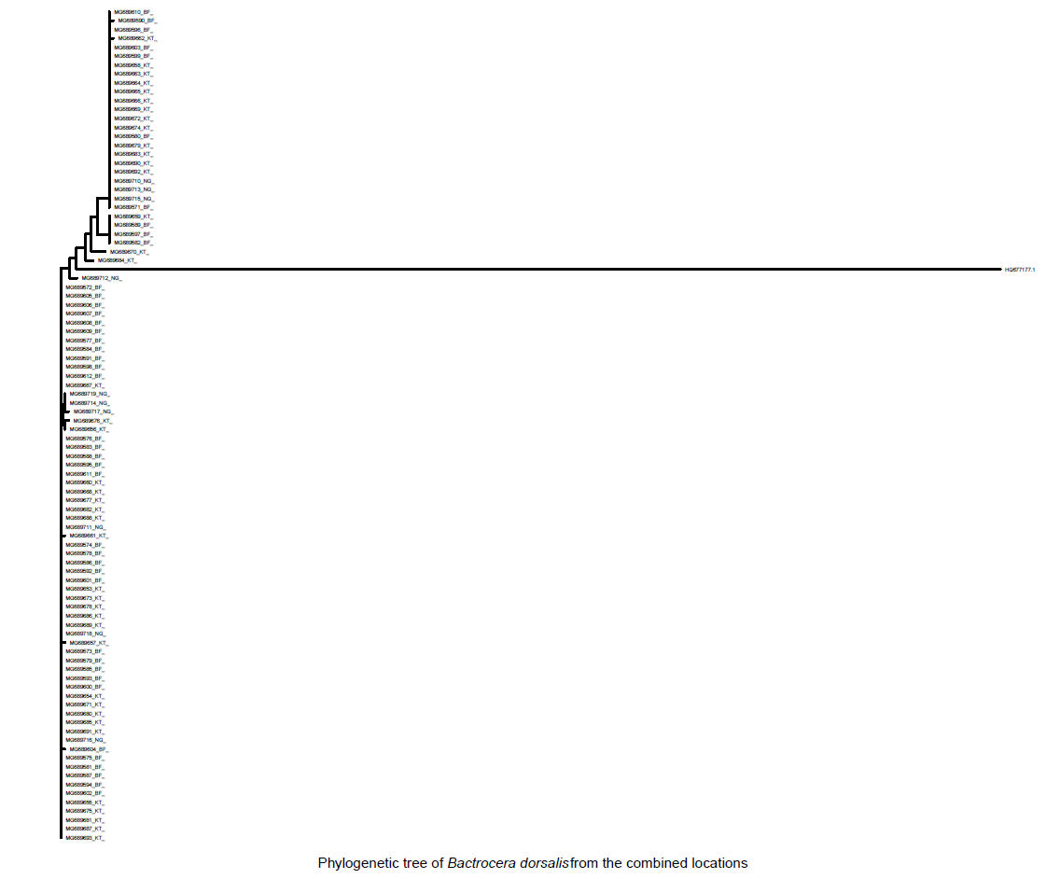
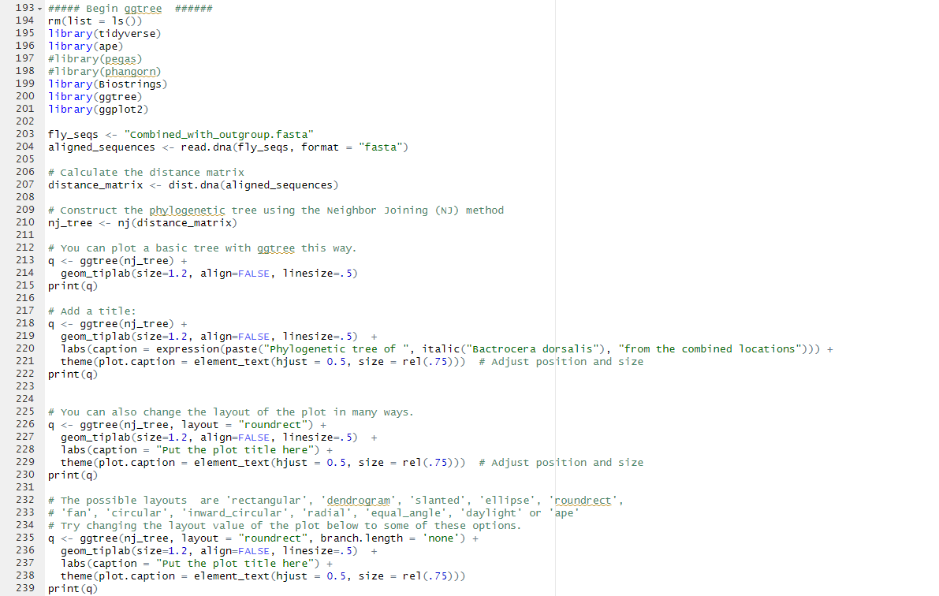
Phylogenetic analysis cont’d

Slide 9
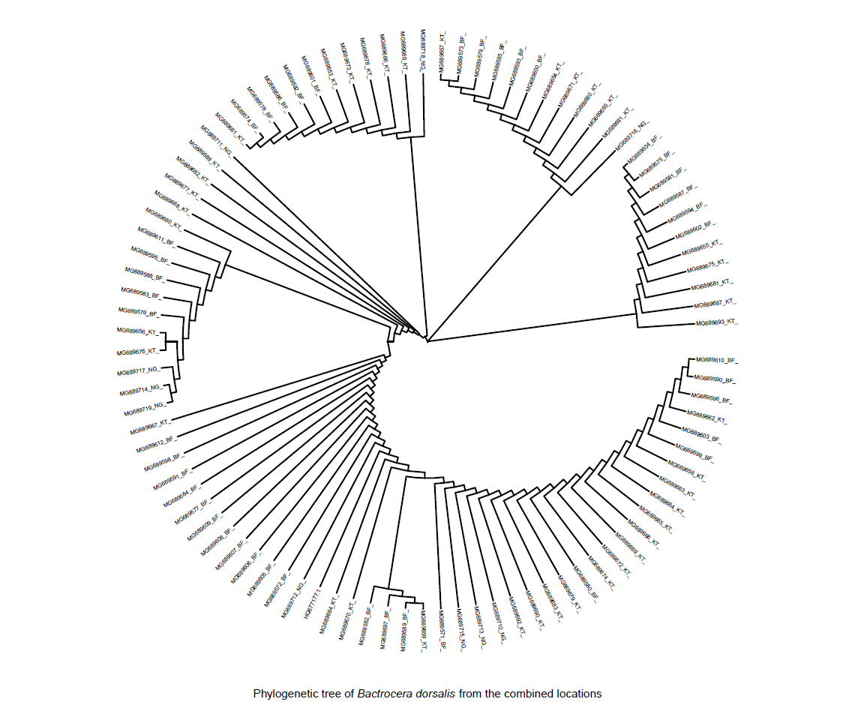
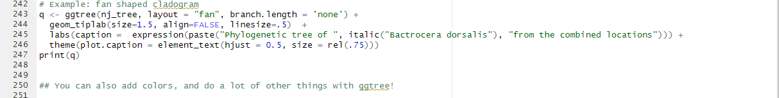
Phylogenetic analysis cont’d

Slide 10

QUESTIONS

